Slide 1


Mobile App For Real-Time Skin Cancer Detection
Group:
Nick Speranza
Lawson Darrow
Nikiraj Konwar
Christian Stevens
Advisor:
Professor Nematzadeh

Slide 2

Goal and Motivation
Skin cancer is one of the most common cancers worldwide.
Early detection is strongly linked to better survival rates.
Many people lack access to dermatologists or routine skin checks.
Current systems are costly, slow, and often inaccessible.
Our solution aims to make prevention and monitoring more accessible.
www.reallygreatsite.com

Slide 3

Key Features
Check a skin spot instantly, anytime
Take a photo or upload an image and get immediate feedback about potential risk.
Get help taking a clear, usable photo
On-screen guidance helps position the camera, improve lighting, and reduce blur before the photo is analyzed.
See past scans and track changes over time
Review previous scans in one place and monitor how a spot changes over time.
Understand what the results mean
Each scan comes with clear explanations, warning signs to look out for, and guidance on when to seek medical advice.
Keep everything private and on the device
All analysis runs directly on the phone, with no cloud uploads required.
Stay proactive with smart follow-ups
Helpful reminders encourage follow-up scans when appropriate, without creating pressure or alarm.

Slide 4

Algorithms and Tools
Algorithms & Tools
Machine Learning
Python with TensorFlow and Keras
Transfer learning using EfficientNet and MobileNetV2
Data augmentation and MixUp regularization
Class weighting and threshold tuning
K-fold cross-validation for model evaluation
Model Deployment
TensorFlow Lite for on-device inference
Optimized for speed and low memory usage
Mobile Application
React for cross-platform Android and iOS development
Guided camera and real-time image capture
Image Processing
Image resizing and normalization
Preprocessing consistent with training pipeline
Supporting Tools
GitHub for version control and collaboration
Standard evaluation libraries for performance analysis

Slide 5
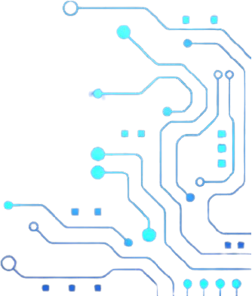

Novel Features
Privacy-first, on-device inference without uploading images to external servers
Real-time skin lesion analysis directly on the mobile device
User-friendly, guided interface integrated with AI predictions
Emphasis on interpretability and responsible result presentation
Optimized deep learning models designed for mobile performance
Combines accuracy, privacy, and usability in a single system
www.reallygreatsite.com

Slide 6

Technical Challenges
Balancing model accuracy with mobile performance limitations
Optimizing high-capacity models for fast on-device inference
Handling dataset imbalance between benign and malignant cases
Ensuring generalization across real-world image quality and lighting conditions
Maintaining high recall for malignant cases while avoiding overfitting
Designing UI messaging that communicates uncertainty responsibly

Slide 7

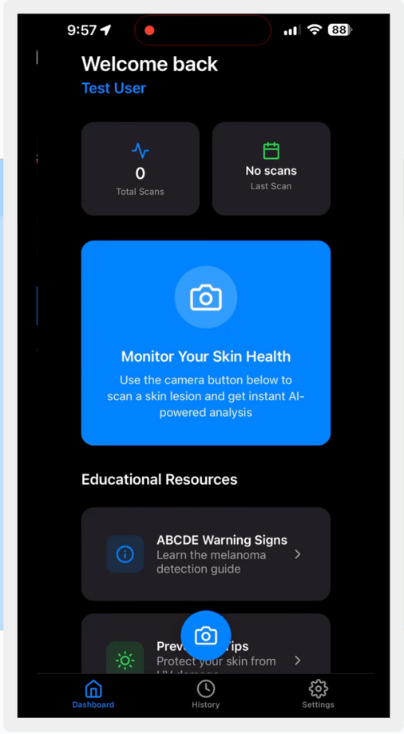
Design and System Architecture
The system consists of four primary modules:
Mobile UI and Camera Interface
Image Preprocessing Pipeline
On-Device ML Inference Engine
Local Storage and Results Management
These modules interact in a linear but modular pipeline, allowing independent testing and refinement.
User and Hardware Interfaces:
The system interfaces directly with smartphone cameras and storage. No external hardware is required.

Slide 8

Evaluation
Classification performance:
Accuracy
Precision
Recall
AUC
Inference speed and responsiveness
Reliability across varied image conditions
User satisfaction via surveys and qualitative feedback

Slide 9

Progress Summary
ML Model: 95% complete
Small Model Testing: 82% complete
App UI: 95% complete
App Features: 89% complete
Remaining work focuses on final optimization and integration

Slide 10
Milestone Plans
Milestone 4 (February 23): Planned Tasks
Finalize and export production-ready ML model
Integrate model into mobile app
Validate preprocessing consistency
Conduct initial integrated testing
Milestone 5 (March 30): Planned Tasks:
Optimize inference speed and stability
Expand testing across edge cases
Conduct user-oriented evaluation
Analyze results and prepare Showcase poster
Milestone 6 (April 20): Planned Tasks
Final system integration and testing
Full system demo
Final evaluation and analysis
Create user and developer manuals
Produce demo video

Slide 11
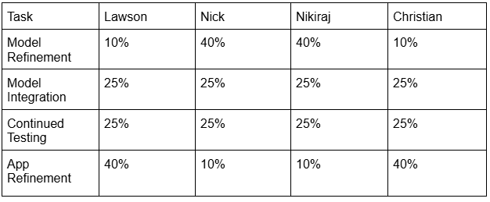
Task Matrix for Milestone 4

Slide 12
Thank You
www.reallygreatsite.com

